Slide 1
BIA 650
Process Innovation and Management
9 – Multi-objective/criterion Decision Making (MCDM)
NLP/GA - Portfolio Analysis
GA – Multiple criterion programming
Goal Programming
Analytic Hierarchy Process
Refer: A&W, 3rd Edition, Ch. 9 or A&W 4th Edition, Ch 16. (online)
© E. A. Stohr, 2017
Notes:
Up to this point, we have been concerned with choosing & designing business processes.
In this lecture, we look at:
Simulation: How to check alternative process designs
WFMS: How to automate processes
Since not all processes can be expressed as fixed workflows, we also look at:
Groupware: How to support coordination in unstructured situations
Finally, we look at 2 real case studies involving the implementation of a WFMS

Slide 2
Portfolio Analysis
Traditional portfolio analysis relies on the following probability theory:
Let:
x’ = (x1, x2, … xn) - random vector of returns
(xi – expected return from stock, i)
w’ = (w1, w2, …. ,wn) – weights that add to 1.
(Proportion of each stock to be purchased)
X = n x n variance-covariance matrix of returns (variances on diagonal)
Then:
Expected return from portfolio = E[w’.x] = w’.E[x]
Expected variance of portfolio = w’.X.w

Slide 3
Portfolio Analysis - GRG
Stock input data | Stock 1 | Stock 2 | Stock 3
Mean return | 0.14 | 0.11 | 0.1 |  | Cov(Xi,Xj ) = Cor(Xi,Xj).Stdev(Xi).Stdev(Xj)
StDev of return | 0.2 | 0.15 | 0.08
Correlations | Stock 1 | Stock 2 | Stock 3 |  | Covariances | Stock 1 |  | Stock 2 |  | Stock 3
Stock 1 | 1 | 0.6 | 0.4 |  | Stock 1 | 0.04 |  | 0.018 |  | 0.0064
Stock 2 | 0.6 | 1 | 0.7 |  | Stock 2 | 0.018 |  | 0.0225 |  | 0.0084
Stock 3 | 0.4 | 0.7 | 1 |  | Stock 3 | 0.0064 |  | 0.0084 |  | 0.0064
Investment decisions
 | Stock 1 | Stock 2 | Stock 3
Fractions to invest | 0.500 | 0.000 | 0.500
Constraint on investing everything
 | Total invested |  | Required value
 | 1.00 | = | 1
Constraint on expected portfolio return |  |  |  |  | =SUMPRODUCT(B5:D5,Fractions_to_invest)
 | Actual return |  | Required return
 | 0.120 | >= | 0.120
Portfolio variance | 0.0148 | =MMULT(Fractions_to_invest,MMULT(G9:I11,TRANSPOSE(Fractions_to_invest))
Portfolio stdev | 0.1217

Slide 4
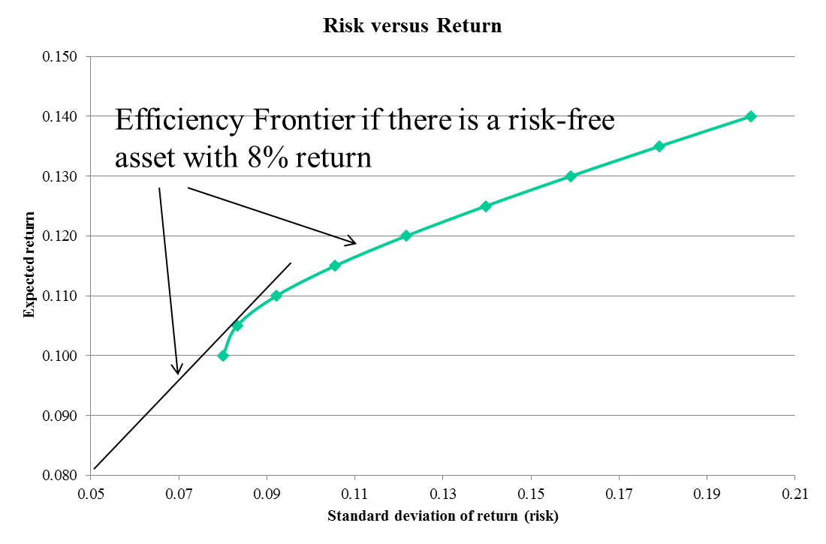
Portfolio Analysis - GRG
As the required return increases from 0.10 to 0.14, the amount invested in stock 1 (highest return but highest risk increases)

Slide 5
Portfolio Analysis - GA
Maximizing the probability of beating the S&P 500
Weights on stocks for portfolio
 | MMM | AA | MO | AXP | AIG | BA | CAT | etc. | (29 companies)
 | 0.22684 | 0.24719 | 0 | 0.22033 | 0 | 0 | 0 | etc.
Constraint on weights |  |  |  |  | Percent of months beating S&P 500
 | Sum weights |  | Required |  | Old % | 70.83%
 | 1 | = | 1 |  | Recent % | 48.21%
Historical data on returns (Feb 99 –Sep 07)
Month | MMM | AA | MO | AXP | AIG | BA | CAT | S&P 500 | Portf Return | Beat S&P?
Feb-99 | -0.0387 | -0.0261 | -0.1650 | 0.0548 | 0.1068 | 0.0311 | 0.0520 | -0.0323 | -0.0100 | Yes
Mar-99 | -0.0448 | 0.0169 | -0.0908 | 0.0870 | 0.0591 | -0.0458 | 0.0081 | 0.0388 | 0.0384 | No
Apr-99 | 0.2582 | 0.5114 | -0.0041 | 0.1100 | -0.0299 | 0.1952 | 0.4085 | 0.0379 | 0.2067 | Yes
May-99 | -0.0305 | -0.1136 | 0.1003 | -0.0738 | -0.0230 | 0.0385 | -0.1477 | -0.0250 | -0.0574 | No
Jun-99 | 0.0139 | 0.1251 | 0.0533 | 0.0769 | 0.0263 | 0.0460 | 0.0933 | 0.0544 | 0.0406 | No
Jul-99 | 0.0115 | -0.0323 | -0.0734 | 0.0124 | -0.0097 | 0.0313 | -0.0175 | -0.0320 | 0.0052 | Yes
Note: No statistics are required here – the correlations are implicit in the returns data and risk is not part of the question in any case.
=COUNTIF(AG13:AG65,“Yes”)/48
=COUNTIF(AG66:AG116,“Yes”)/56
=SUMPRODUCT(B13:AD13,Weights)

Slide 6
Portfolio Analysis - GA
Using Solver’s “Evolver” GA:
    Constraints:
    Weights > 0
    Weights < 1
    Sum Weights = 1
Only find a good, not necessarily the optimal, solution
Use different random number seeds
As in this example, GA can be used with very non-linear and discontinuous functions e.g., with all of Excel’s “IF”, “COUNTIF”, “MIN”, “MAX”, etc. functions.

Slide 7
Multi-criteria Problems
Many problems (in fact probably most) involve situations where multiple objectives are to be optimized.
Four fundamental approaches:
Consider constraints as goals, include in objective function, explore simultaneously (“satisficing”): GA example
Goal Programming: Prioritize the objectives, optimize objectives one at a time (another “satisficing” approach)
Trade-off Curves. Optimize one objective and constrain others to be no worse than specified values. (Satisficing – pareto optimality concept.)
Analytic Hierarchy Process (AHP): Weight the objectives to determine their relative importance.

Slide 8
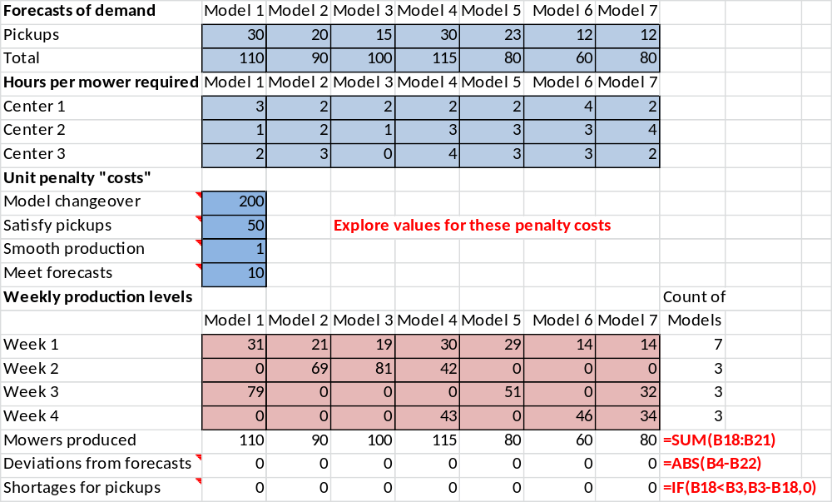
Ex 8.4 Simultaneous Search

Slide 9
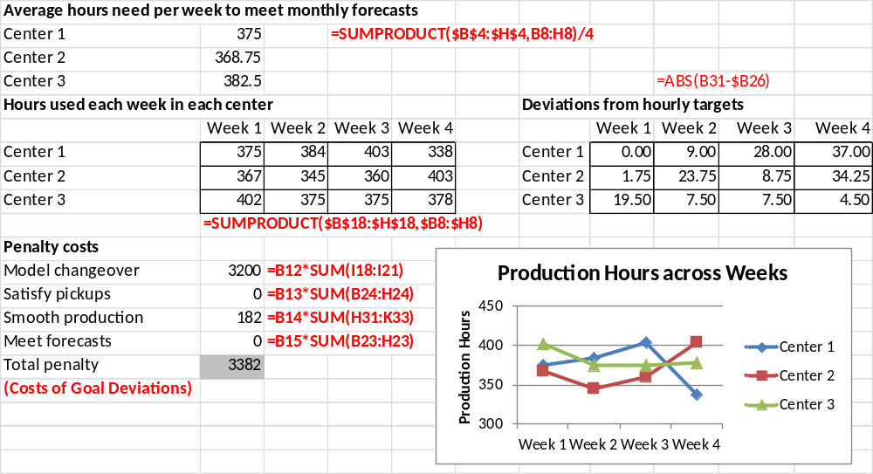
Ex 8.4 Simultaneous Search (ctd.)
This seems like a pretty good solution (satisficing)!

Slide 10
Goal Programming
“Economic man” is rational, has stable preferences, and seeks to optimize in the sense of allocating his available resources to maximize the attainment of his preferences. But if there are multiple preferences (goals) these may not all be optimized at once – trade-offs may be necessary.
For an organization, there may be a debate about its appropriate goal – for example profit maximization or revenue growth or responsibility to society?
Goal programming allows a simultaneous solution to a system of multiple objectives by first satisfying the most important objective, then the second most important, and so on.
Hard constraints (such as a budget constraint) must be satisfied.
Soft constraints (such as the RHSs of desirable but not imperative constraints) must be satisfied as closely as possible; these are prioritized.

Slide 11
Goal Programming (ctd)
In goal programming, we introduce negative d⁻ and positive d⁺ deviations from the RHS goal values in the constraints.
e.g., AX = b can be represented by Ax + d⁻ - d⁺ = b
Either: d⁺ = Ax-b > 0 and d⁻ = 0 OR d⁻ = b-Ax > 0 and d⁺ = 0
Then we try to minimize the deviations from the RHS goal values. We must satisfy balance equations:
LHS value + d⁻ – d⁺ = RHS goal value [d⁻ = slack; d⁺ = surplus]
Note that a system of simultaneous equations, Ax = b, that has an exact solution can be solved by the LP formulation:
Min d⁺ + d⁻
Subject to:
Ax + d⁻ - d⁺ = b
x > 0

Slide 12
Goal Programming – ctd.
In W&A Ch 16(9) Example 16.1 the fundamental balance equation above is written as:
LHS value + d⁻ – d⁺ = RHS goal value
LHS value + Amt under goal – Amt over goal = Balance = RHS goal value
Where the balance is an accounting variable

Slide 13
Advertising Problem - LP
Exposures | Sports ad | Game show ad | News show ad | Sitcom ad | Drama ad | Soap opera ad
High-income men | 7 | 3 | 6 | 4 | 6 | 3
High-income women | 4 | 5 | 5 | 5 | 8 | 4
Low-income people | 8 | 6 | 3 | 7 | 6 | 5
Cost/unit | 120 | 40 | 50 | 40 | 60 | 40
Advertising plan
 | Sports ad | Game show ad | News show ad | Sitcom ad | Drama ad | Soap opera ad
Minimum ads required | 2 | 0 | 2 | 0 | 2 | 0
 | <= | <= | <= | <= | <= | <=
Number purchased | 2.000 | 0.000 | 2.000 | 4.000 | 3.333 | 0.000
 | <= | <= | <= | <= | <= | <=
Maximum ads allowed | 10 | 10 | 10 | 10 | 10 | 10
Budget constraint | Total cost |  | Budget
 | $700 | <= | $700
Goals for numbers of exposures |  |  |  |  | Exposures in millions
 | Exposures |  | Goal |  | Costs in thousands
High-income men | 62.000 | >= | 65
High-income women | 64.667 | >= | 72
Low-income people | 70.000 | >= | 70
Not feasible!

Slide 14
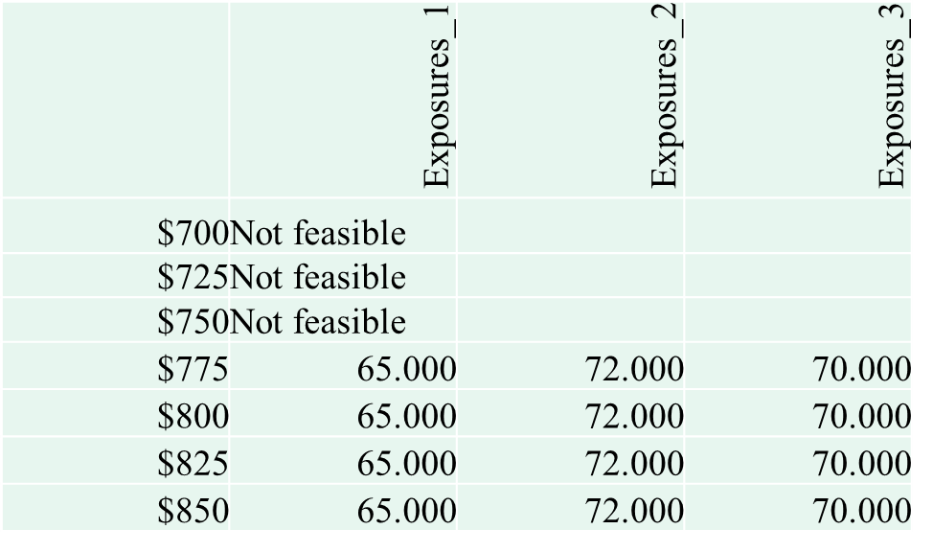
Goal Programming – Solver Table
Solving the above LP with no objective function one finds that there is no feasible solution to this set of inequalities.
Using a one-way Solver Table, we can find the minimum budget level that is feasible.

Slide 15
Goal Programming Steps
Add d⁺ and d⁻ as decision variables.
Prioritize the goals associated with the soft constraints:
HIM > ~ HIW >~ LIP
1. Minimize the deviation, d⁻, (amount under the goal) for the highest priority goal. Let the other soft constraints (goals) vary.
2. Minimize the deviation, d⁻, amount under the goal for the next highest priority goal while keeping the deviation obtained for the previous (higher priority) goals fixed and letting the remaining soft constraints (goals) vary.
Repeat step 2 until all the soft goals have been optimized,

Slide 16
Advertising Goal Program Setup
Exposures | Sports ad | Game show ad | News show ad | Sitcom ad | Drama ad | Soap opera ad
High-income men | 7 | 3 | 6 | 4 | 6 | 3
High-income women | 4 | 5 | 5 | 5 | 8 | 4
Low-income people | 8 | 6 | 3 | 7 | 6 | 5
Cost/unit | 120 | 40 | 50 | 40 | 60 | 40
Advertising plan | Sports ad | Game show ad | News show ad | Sitcom ad | Drama ad | Soap opera ad
Minimum ads required | 2 | 0 | 2 | 0 | 2 | 0
 | <= | <= | <= | <= | <= | <=
Number purchased | 2.000 | 0.000 | 5.000 | 2.250 | 2.000 | 0.000
 | <= | <= | <= | <= | <= | <=
Maximum ads allowed | 10 | 10 | 10 | 10 | 10 | 10
Budget constraint | Total cost |  | Budget
 | $700 | <= | $700
Goals for numbers of exposures | Exposures | Amt under goal | Amt over goal | Balance |  | Goal
High-income men | 65.000 | 0 | 0 | 65.000 | = | 65
High-income women | 60.250 | 11.75 | 0 | 72.000 | = | 72
Low-income people | 58.750 | 11.25 | 0 | 70.000 | = | 70
 | Deviation under |  | Already obtained
HIM deviation | 0.000 | <= | 65.000 | Deviations from goals (amounts below
HIW deviation | 11.750 | <= | 72.000 | goals, or 0 if currently meeting goal)
LIP deviation | 11.250 | <= | 70.000

Slide 17
Advertising Goal Program - 2
Exposures | Sports ad | Game show ad | News show ad | Sitcom ad | Drama ad | Soap opera ad
High-income men | 7 | 3 | 6 | 4 | 6 | 3
High-income women | 4 | 5 | 5 | 5 | 8 | 4
Low-income people | 8 | 6 | 3 | 7 | 6 | 5
Cost/unit | 120 | 40 | 50 | 40 | 60 | 40
Advertiznig Plan | Sports ad | Game show ad | News show ad | Sitcom ad | Drama ad | Soap opera ad
Minimum ads required | 2 | 0 | 2 | 0 | 2 | 0
 | <= | <= | <= | <= | <= | <=
Number purchased | 2.000 | 0.000 | 5.000 | 0.000 | 3.500 | 0.000
 | <= | <= | <= | <= | <= | <=
Maximum ads allowed | 10 | 10 | 10 | 10 | 10 | 10
Budget constraint | Total cost |  | Budget
 | $700 | <= | $700
 | Exposures | Amt < goal | Amt > goal | Balance |  | Goal
High-income men | 65.000 | 0 | 0 | 65.000 | = | 65
High-income women | 61.000 | 11 | 0 | 72.000 | = | 72
Low-income people | 52.000 | 18 | 0 | 70.000 | = | 70
 | Deviation under |  | Already obtained
HIM deviation | 0.000 | <= | 0.000 | After minimizing third goal
HIW deviation | 11.000 | <= | 11.000
LIP deviation | 18.000 | <= | 70.000

Slide 18
GP - Sensitivity Analysis
Change the ordering of the priorities:
Priority 1 | Priority 2 | Priority 3 | HIM deviation | HIW deviation | LIP deviation
HIM | HIW | LIP | 0 | 11 | 18
HIM | LIP | HIW | 0 | 11.75 | 11.25
HIW | HIM | LIP | 3 | 6 | 12
HIW | LIP | HIM | 3 | 6 | 12
LIP | HIM | HIW | 1.956 | 9.304 | 0
LIP | HIW | HIM | 3 | 7.333 | 0
This provides a very insightful way to do a sensitivity analysis!

Slide 19
AHP Approach – Pairwise Comparisons
Example:
Preferences among beverages
e.g., Coffee is preferred 7 times more than wine.
n(n-1)/2 comparisons are made.
Usually these are displayed in a matrix for computational purposes.
Paired
Comparison | Weight
Coffee-Wine | 7
Coffee-Tea | 4
Coffee-Beer | 5
Coffee-Soda | 6
Coffee-Milk | 3
Coffee-Water | 2
Wine-Tea | 8
Wine-Beer | 2
Wine-Soda | 3
Wine-Milk | 4
Wine-Water | 5
Tea-Beer | 12
Tea-Soda | 2
Tea-Milk | 3
Tea-Water | 4
Beer-Soda | 7
Beer-Milk | 6
Beer Water | 5
Soda-Milk | 4
Soda-Water | 3
Milk-Water | 3
Intensity of Performance | Definition | Explanation
1 | Equal Importance | Two activities (entities) contribute equally to the objective
2 | Weak or slight
3 | Moderate importance | Experience and judgment slightly favor one activity (entity) over the other
4 | Moderate plus
5 | Strong importance | Experience and judgement stringly favor one activity (entity) over another
6 | Strong plus
7 | Very strong or demonstrated importance | An activity (entity) is strongly favored over another; its dominance is demonstrated in practice
8 | Very, very strong
9 | Extreme importance | The evidence favoring one activity (entity) over another is of the highest possible order of affirmation
e.g. | 1.1 - 1.9 | Small, discernable difference
Conventionally, the weights are integers 1 through 9 with the above meanings. Decimal weights can be used if finer distinctions are discernable.

Slide 20
AHP Approach
The generic AHP Multi-criterion Problem consists of a hierarchy of goals, criteria and alternatives as in the example in A&W Ch 16 (formerly Ch 9).
Goal:
Relative importance
weights, w
Criteria: Salary (S) Quality of Life (Q) Interesting (I) Near to Family (N)
Choices: Job 1 (J1) Job 2 (J2) Job 3 (J3)
Relative scores of jobs on salary, Js
The objective is to find the job, which best satisfies the combined weighted preferences for Salary, Quality of Life, Interestingness. and Nearness to Family.
Select a Job

Slide 21
AHP: Forming Comparison Matrices
Job selection using analytical hierarchy process
W & A Ch 16, Example 16.4
Pairwise comparisons among objectives
 | Salary | Life quality | Work interest | Near family
Salary | 1 | 5 | 2 | 4
Life quality | 1/5 | 1 | 1/2 | 1/2
Work interest | 1/2 | 2 | 1 | 2
Near family | 1/4 | 2 | 1/2 | 1
Use this matrix to form a vector, w, of the relative importance of objectives
Pairwise comparisons among jobs on salary
 | Job 1 | Job 2 | Job 3
Job 1 | 1 | 2 | 4
Job 2 | 1/2 | 1 | 2
Job 3 | 1/4 | 1/2 | 1
Use to form a vector, j_{s}, of the relative importance of each job wrt the Salary objective
Pairwise comparisons among jobs on quality of life
 | Job 1 | Job 2 | Job 3
Job 1 | 1 | 1/2 | 1/3
Job 2 | 2 | 1 | 1/3
Job 3 | 3 | 3 | 1
Use to form a vector, J_{q}, of the relative importance of each job wrt the qual life objective
Pairwise comparisons among jobs on interest of work Etc.
Note these are “anti-symmetrical” square matrices (for consistency, a_{ji} = 1/a_{ij})

Slide 22
AHP (ctd)
Then a vector of job rankings, r, can be found by the following matrix multiplication;
r = J.w
Where the matrix J = [j_{s} | j_{q} | j_{i} | j_{n}]
In example, W&A 16.4,
w = (0.5115, 0.0986, 0.2433, 0.1466) and
J =
r =
 | salary | Life quality | Work interest | Near family
Job 1 | 0.5714 | 0.159 | 0.088 | 0.082
Job 2 | 0.2857 | 0.252 | 0.669 | 0.315
Job 3 | 0.1429 | 0.589 | 0.243 | 0.602
0.3415
0.3799
0.2786
Job 2 has the highest score

Slide 23
Job Selection Using AHP (ctd)
Pairwise comparisons among objectives |  |  |  |  |  | Normalized matrix |  |  |  |  | Weights |  | Product | Ratios
 | Salary | Life quality | Work interest | Near family
Salary | 1 | 5 | 2 | 4 |  | 0.5128 | 0.5000 | 0.5000 | 0.5333 |  | 0.5115 |  | 2.0774 | 4.0611
Life quality | 1/5 | 1 | 1/2 | 1/2 |  | 0.1026 | 0.1000 | 0.1250 | 0.0667 |  | 0.0986 |  | 0.3958 | 4.0161
Work interest | 1/2 | 2 | 1 | 2 |  | 0.2564 | 0.2000 | 0.2500 | 0.2667 |  | 0.2433 |  | 0.9894 | 4.0672
Near family | 1/4 | 2 | 1/2 | 1 |  | 0.1282 | 0.2000 | 0.1250 | 0.1333 |  | 0.1466 |  | 0.5933 | 4.0459
 |  |  |  |  |  |  |  |  |  |  |  |  | CI | 0.0159
Pairwise comparisons among jobs on salary |  |  |  |  |  | Normalized matrix |  |  |  |  | Scores |  | CI/RI | 0.0176
 | Job 1 | Job 2 | Job 3
Job 1 | 1 | 2 | 4 |  |  | 0.5714 | 0.5714 | 0.5714 |  |  | 0.5714 |  | 1.7143 | 3
Job 2 | 1/2 | 1 | 2 |  |  | 0.2857 | 0.2857 | 0.2857 |  |  | 0.2857 |  | 0.8571 | 3
Job 3 | 1/4 | 1/2 | 1 |  |  | 0.1429 | 0.1429 | 0.1429 |  |  | 0.1429 |  | 0.4286 | 3
 |  |  |  |  |  |  |  |  |  |  |  |  | CI | 0
Pairwise comparisons among jobs on quality of life |  |  |  |  |  | Normalized matrix |  |  |  |  | Scores |  | CI/RI | 0.0000

Slide 24
Job Selection Using AHP (ctd)
(This region of the spreadsheet contains the calculations for the relative importance of each job on Quality of Life, Interestingness of Job and Closeness to Family.)
Determining best job
Matrix of scores |  | Matrix J
 | Salary | Life quality | Work interest | Near family |  | Weighted scores
Job 1 | 0.5714 | 0.159 | 0.088 | 0.082 |  | 0.3415
Job 2 | 0.2857 | 0.252 | 0.669 | 0.315 |  | 0.3799
Job 3 | 0.1429 | 0.589 | 0.243 | 0.602 |  | 0.2786
r = J.w
Job 2 is the most desirable job taking into account all of the considerations that the job-seeker thinks are important

Slide 25
In-class AHP Experiment
AHP Example: Paired Comparisons
 |  |  |  |  |  |  |  |  |  |  |  | TRUE | Inches | Weights
Example | What are the true ratios of the lengths of the lines? |  |  |  |  |  |  |  |  |  |  | L1 | 11 | 0.180
 |  |  |  |  |  |  |  |  |  |  |  | L2 | 5 | 0.082
 |  |  |  |  |  |  |  |  |  |  |  | L3 | 28 | 0.459
 |  |  |  |  |  |  |  |  |  |  |  | L4 | 17 | 0.279
Team 1 |  |  |  |  |  |  |  |  |  |  |  |  |  | 1
Paired |  |  | Anti-symmetrical Matrix |  |  |  |  |  | Normed Matrix
Comparison | Weight |  |  | L - 1 | L - 2 | L - 3 | L - 4 |  |  | L - 1 | L - 2 | L - 3 | L - 4 | Weights | ABS Diff | Diff²
L1 - L2 | 2 |  | L - 1 | 1 | 2 | 0.4 | 0.7 |  | L - 1 | 0.182 | 0.182 | 0.182 | 0.182 | 0.182 | 0.002 | 0.000
L1 - L3 | 0.4 |  | L - 2 | 1/2 | 1 | 0.2 | 0.3 |  | L - 2 | 0.091 | 0.091 | 0.091 | 0.091 | 0.091 | 0.009 | 0.000
L1 - L4 | 0.667 |  | L - 3 | 2.50 | 5.00 | 1 | 1.7 |  | L - 3 | 0.455 | 0.454 | 0.455 | 0.455 | 0.455 | 0.004 | 0.000
L2 - L3 | 0.2 |  | L - 4 | 1.50 | 3.00 | 3/5 | 1 |  | L - 4 | 0.273 | 0.273 | 0.273 | 0.273 | 0.273 | 0.006 | 0.000
L2 - L4 | 0.333 |  |  |  |  |  |  |  |  | 1 | 1 | 1 | 1 | 1 | 0.005 | 0.006
L3 - L4 | 1.667 |  |  |  |  |  |  |  |  |  |  |  |  |  | MABSE | RMSE

Slide 26
AHP Bibliography
A good introduction to AHP is: http://en.wikipedia.org/wiki/Talk:Analytic_Hierarchy_Process/Example_Leader
Thomas L. Saaty (1980). The Analytic Hierarchy Process: Planning, Priority Setting, Resource Allocation, ISBN 0-07-054371-2, McGraw-Hill

